Slide 1



Introduction to AngularJS 1
Mark J. Buckler
OCPJP,CIWJS

Slide 2

Credits
Some of the contents of this slide presentation have been referenced and reproduced, from Learning AngularJS 1, by Ray Villalobos, ©2018 LinkedIn Corporation.

Slide 3
LEARNING OBJECTIVES
Setting Up the Project
What is AngularJS
Binding and Directives
Modules and Controllers
Image Display Problems with AngularJS

Slide 4
What is AngularJS
Features
AngularJS is a framework
This implies that instead of writing code however you want, you follow the standards set by the framework
It is designed for creating single page web applications
Directives
Commands that can be added to HTML to give it “superpowers”
Look exactly like HTML attributes that are added to a normal tag

Slide 5
What is AngularJS
Structural Features
AngularJS uses an MVC architecture for its framework: Model View Controller
Model
The model is the part of the structure that deals with the data
View
The view is a template system that allows us to add AngularJS code into HTML pages
Controller
The JavaScript that links the Model to the View, or the data to the template

Slide 6
What is AngularJS
Data Binding
The ability to bind the Model and the Views together
AngularJS employs two-way data binding
If something changes to a variable in the view, it will cause the scripts to do something to reflect it
They are both tied, or bound, together
Expressions
AngularJS uses double curly braces ( {{ }} ) to add expressions to HTML
They enable output from the Controller into the View

Slide 7
What is AngularJS
AngularJS vs Angular
AngularJS is technically the old version of the framework
It split apart into first Angular 2, then Angular 4, then just plain Angular
It is a complete rewrite of the framework
It uses a component-based architecture instead of MVC
More similar to ReactJS and Vue.js, we will study later
Why AngularJS 1
It is much more stable, the others are changing quickly
MVC is a valuable architectural pattern, e.g. Android
It is a simpler, building block starting point

Slide 8
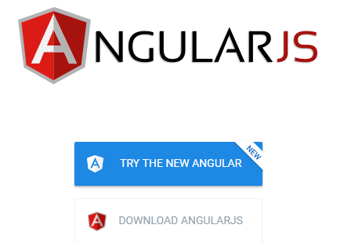
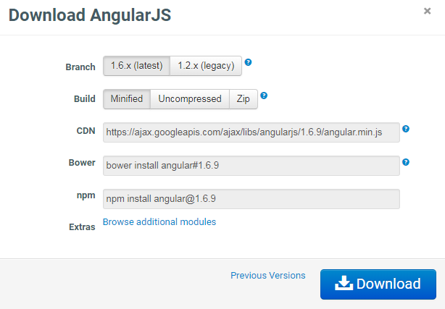
What is AngularJS
Installing AngularJS
Website: https://angularjs.org/

Slide 9

What is AngularJS
Programming Exercise04_01_01 – Step 1
Setting Up the Project

Slide 10
Binding and Directives
AngularJS Scripts
To implement AngularJS in the HTML we will need to add its various <script> elements
There are a number of different AngularJS scripts for implementing various pieces of functionality
They are available on the AngularJS.org website
AngularJS scripts should always be at the beginning of the page
This allows the application to be managed by AngularJS

Slide 11
Binding and Directives
Data Binding
Creates a relationship between the data and the rest of the code
AngularJS employs directives to enable the process
Directives
A directive is an AngularJS command
They almost always begin with an ng- prefix
Directives appear to be HTML attributes
AngularJS Scripts
To implement AngularJS in the HTML we will need to add its <script> elements
AngularJS script should always be at the beginning of the page

Slide 12
Binding and Directives
ng-app Directive
Declares the part of the HTML code that we want to use as an application
May encompass the entire code
May mark off just a section of the code

Slide 13
Binding and Directives
ng-model Directive
Creates a variable in the application scope
It is placed inside an HTML <form> element
This allows the variable to be accessed within both the HTML template and the JS scripts
This is the actual implementation of two way data binding
Expressions are used as a way to display data in the template: {{ }}

Slide 14
Binding and Directives
Programming Exercise04_01_01 – Step 2
Implementing Directives and Expressions

Slide 15
Modules and Controllers
Modules
An angular.module()is a container for different parts of an application
A module connects with the HTML by using the ng-app directive
var app = angular.module(’myApp’, []);
A module can contain AngularJS components called controllers
A module may have multiple controllers
Controllers may be specified to handle different parts of an application

Slide 16
Modules and Controllers
Controller Features
Controllers are created using the controller()constructor
To specify where a specific controller handles functionality, use the ng-controller directive
Controllers may also be defined to have various dependencies
A dependency is something that a controller needs in order to work

Slide 17
Modules and Controllers
$scope
Used as one of the most common ways to initialize components
$scope acts as a special variable
It can be thought of as a global object
If we insert a property within the $scope, it means that it can be used within the HTML in the app

Slide 18
Modules and Controllers
Programming Exercise04_01_01 – Step 3
Implementing Modules and Controllers

Slide 19
Image Problems with AngularJS
Image Problem
AngularJS expressions are often used in the src attribute of <img> elements
src="images/{{artist.shortname}}_tn.jpg"
The HTML DOM loads before the Controller can pass dynamic data through the Model
Usually this does not matter and is not noticeable with regular data
However, <img> elements appear to the browser as resources, so can throw 404 errors
Solution is a special AngularJS directive: ng-src

Slide 20
Image Problems with AngularJS
Programming Exercise04_01_01 – Step 4
Fixing AngularJS Image Problems

